Slide 1
2D Hybrid Analytical Model Performance Optimization for Linear Induction Motors
Presented By: | Michael Thamm
 | M.A.Sc. Candidate
Supervisor: | Dr. Narayan C. Kar
Final Oral Defense Date: | May 19, 2022
Final Oral Defense Time: | 12:00 pm

Slide 2
Outline
I. |  | Research Objectives
II. |  | Literature Review
III. |  | Knowledge Gap and Novelty
IV. |  | Research Methodology
V. |  | Optimization Results
VI. |  | Conclusions
VII. |  | Future Research
VIII. |  | Publications to Date
IX. |  | Comments & Questions

Slide 3




Research Objectives
Motor Level Objective:
Produce the optimal motor within the sub-category of double-layer, single-sided, 3-phase, integral slot winding, linear induction motor (LIM).
Model Level Objective:
Less than 5% hybrid analytical model (HAM) modelling error compared to transient analysis using ANSYS Electronics finite element analysis (FEA) and include robust feasibility checks on the solver validating the motor manufacturability.
Solver Level Objective:
Pareto-optimal solutions using a non-dominated sorting genetic algorithm II (NSGAII) optimization workflow that outperform the alternative motors in most performance parameters while maintaining computational efficiency.
Global Objective:
Produce a novel holistic model which includes flexible motor modelling, modified constraints, multi-objective optimization, and field plotting to serve as a design tool to automate producing optimal motor designs within their constrained domain.

Slide 4
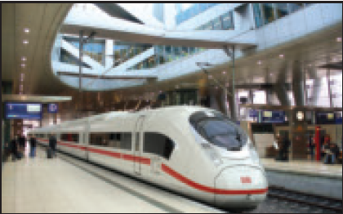
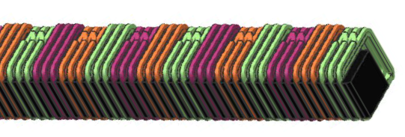
Current Electric Trains
Table 1. Comparison Between Electric Vehicles 2022 [1]–[2]
⁽¹⁾ Testing performance exceeds regulated performance
Vehicle Specifications | Siemens Velaro D (DB Class 407) | Swissloop
Motor Type | RIM | LIM
Average Thrust | - | 1.2 kN @ 200 kg
Peak Thrust | 19 kN (per wheelset) | 2.8 kN
Acceleration (0 to 100 km/h) | 69.4 s ⁽¹⁾ | 2.35 s
Top Speed | 320 km/h | 252 km/h
Average Power | 500-600 kW | 90 kW
Peak Power | - | 250 kW
Fig. 1. 2013 ICE Siemens Velaro D powered train. [3]
Fig. 2. Swissloop linear induction motor with toroidal windings. [2]
Electric trains are an efficient and environmental means of transportation demanding high-speed, efficient and mechanically robust motor integrations.

Slide 5
Induction Motor Modeling for Optimization
Table 2. Advantages and Disadvantages of Analytical Models [4]–[7]
FEA |  | MEC |  | Harmonic Model (HM)
Advantage | Disadvantage | Advantage | Disadvantage | Advantage | Disadvantage
Machine code and modern modelling techniques combine accuracy and efficiency Accurately models magnetic and electrical losses | High computation demand for dense-mesh, transient simulations | Accurately models complex geometries with a relatively dense mesh | Discretization of the spatial domain scales with model complexity Errors in the solution occur near abrupt changes in source potential | The computation intensity only scales with harmonics, not mesh density Lack of discretization, allows for solution at any spatial position within the region | Inaccurately models complex geometries Requires many harmonics to accurately predict the waveform
FEA software is the industry standard, although hybrid models are accurate and computationally competitive.

Slide 6
Induction Motor Modeling for Optimization
Table 3. Advantages and Disadvantages of Analytical Models [8]–[11]
Increase Slots | Advantage | Better primary field sin wave approximation resulting in improved efficiency Reduced mass due to the metal core being denser than the combination of copper and insulation in the slots
 | Disadvantage | Complex to manufacture and wind the coils Localized saturation of the primary core if the primary tooth width is too low
Increase Poles | Advantage | Improved operating efficiency Reduced mass
 | Disadvantage | Increased eddy current losses Reduced maximum speed Reduced thrust force
There are trade-offs when modify motor meta-parameters such as primary motor slots and poles.

Slide 7
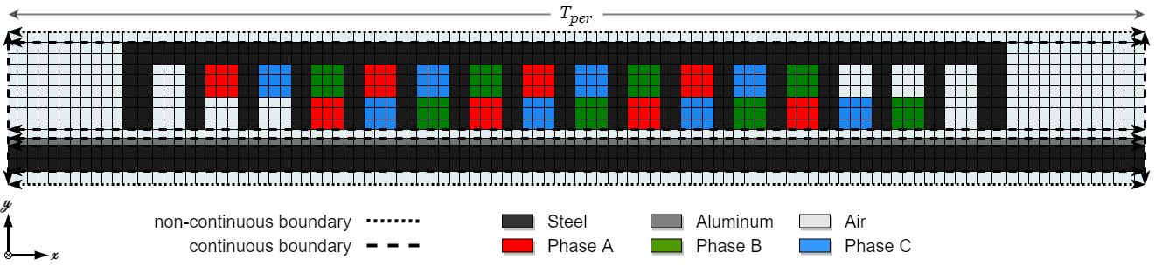
Hybrid Analytical Model
Flexible Modelling
Allows for modelling a wide variety of motor and winding configurations [12], [13]
Fig. 3. Meshed double-layer linear induction motor model containing boundary conditions and regions.
Dense HAM meshing accurately models complex motor configurations.

Slide 8
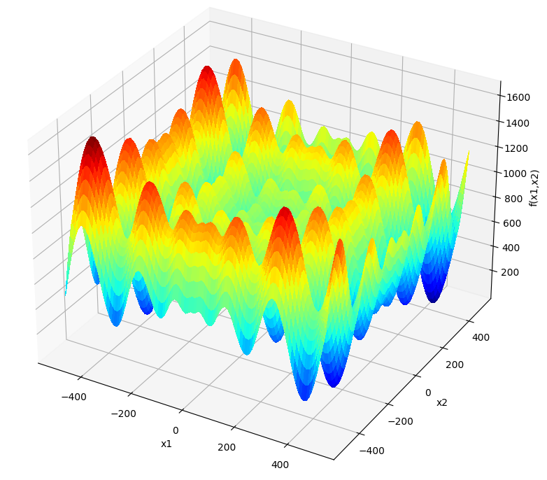
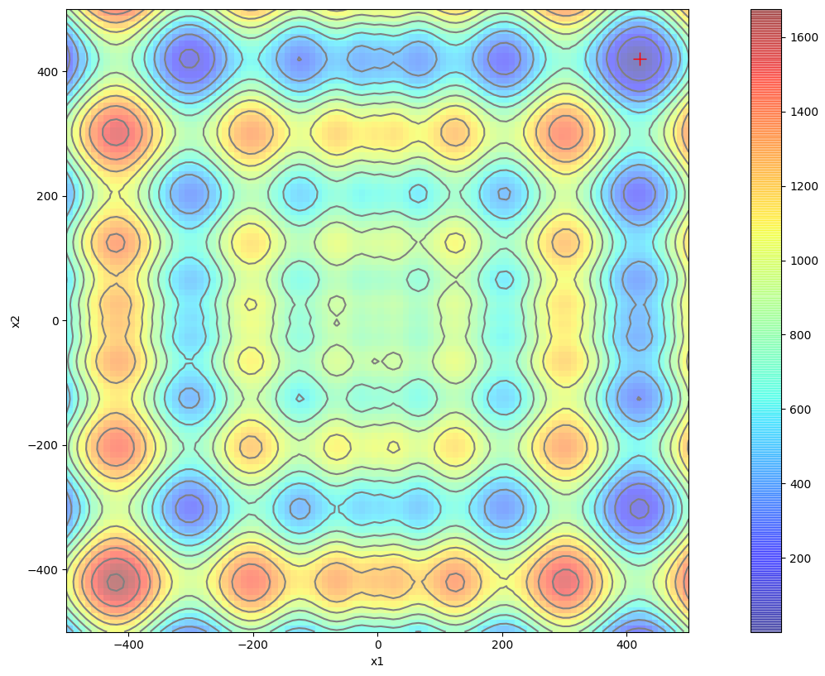
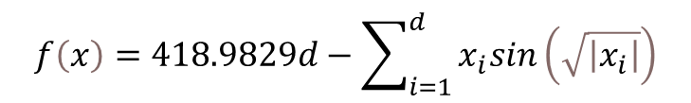

Optimization Algorithm Test Function
$$f\left(x\right)=418.9829d−\sum_{i=1}^{d}{x_{i}sin\left(\sqrt{\left|x_{i}\right|}\right)}$$
Schwefel Test Function:
(1)
Table 4. Optimization Algorithm Performance
Optimization Algorithm | PSO | GA
Total Iterations | 57 | 116
Objective Function Executions | 10760 | 4171
Algorithm Run Time (s) | 1.5246 | 1.4546
X1 Solution | 420.9728 | 420.9522
X2 Solution | 420.9669 | 420.9729
Function Value at Solution | 0.0001 | 0.0002
Error In Solution (%) | 0.0052 | 0.0195
A test function such as (1) creates a common baseline among optimization algorithms (OA) for objective comparison
Global Minimum: $f\left(420.9687, 420.9687\right)=0$
Fig. 4. Depicts a surface and contour plot of the Schwefel Function and its global minima.
GA selected as OA due to efficiency and solution accuracy for multi-objective applications.

Slide 9
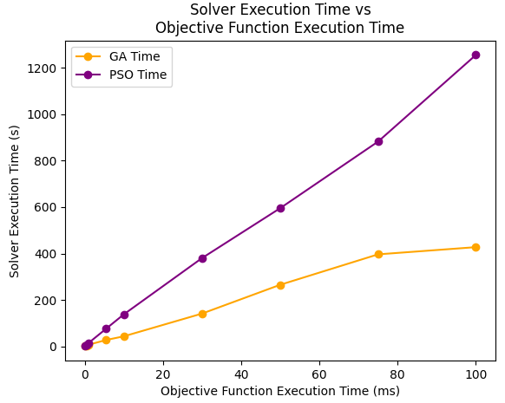
Optimization Algorithm Selection
Extrapolating computation intensity predicts the intensity experienced by the optimization workflow.
Table 5. OA Configuration for Extrapolated Comparison
PSO |  | GA
Population/Swarm Size | 200 | Population Size | 200
Max Leader Size | 100 | Offspring Size | 100
Comparator Key | Objective Value | Crossover Percentage | 30 %
Mutation Percentage | 10 % | Mutation Percentage | 10 %
Algorithm Stall Iterations | 25 | Algorithm Stall Iterations | 25
Fig. 5. Comparison of the average solver execution time between GA and PSO until 25 stall iterations are achieved using the Schwefel test function at different artificial objective function execution times.
The execution time plots of GA and PSO diverges as the objective function execution time increases.

Slide 10
Knowledge Gap and Novelty
Knowledge Gap
Modern motor modelling software lacks the ability to optimize across motor meta-parameters, constraining motor designers to low-level motor optimizations.
Some software offers multi-objective optimization and access to their modelling application programmable interface (API) [14], offering a solution, although a motor designer is constrained by the lack of transparency into the backend modelling code.
Novelty
Robust, non-dominated multi-objective sorting GA optimizing for the optimal motor within a sub-category of linear induction motors.
The HAM uses a flexible winding distribution table while considering transverse end-effects, core saturation, skin effect, and motor manufacturability.
The optimal slot-pole relationship is determined within the provided motor domain.

Slide 11

Winding Distribution Table
Table 6. WDT for 12 Slots and 4 Poles Winding [15]
 | Upper Layer |  |  |  | Lower Layer
Coil Direction | + | + | - | - | - | - | + | +
Phase A | 1 | 7 | 2 | 8 | 4 | 10 | 5 | 11
Phase B | 3 | 9 | 4 | 10 | 6 | 2 | 7 | 1
Phase C | 5 | 11 | 6 | 12 | 8 | 2 | 9 | 3
Equation (2) targets the 5th and 7th harmonic and defines the coil pitch for double-layer windings
$$y_{c}=\frac{5}{6}y_{p}$$ | (2)
The winding distribution table (WDT) is easily re-written into an algorithm within the objective function
A flexible motor optimization requires a flexible winding formulation that covers a wide variety of competitive winding strategies.

Slide 12
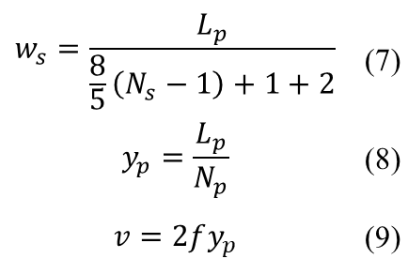
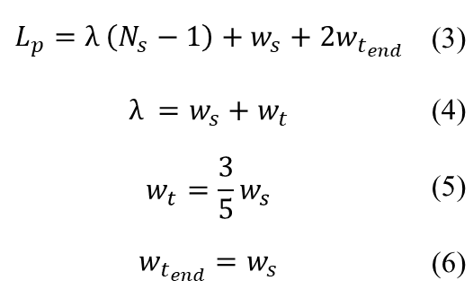
Defining Primary Motor Relationships
Equation (5) is carefully chosen to balance the saturation constraint
Equation (6) allows for larger end teeth to reduce end-effects and maximize incoming flux density
Equation (7) provides a slot width related to the primary motor’s number of slots and length
Equation (8) and (9) relate the velocity to the number of poles
$$L_{p}=λ \left(N_{s}−1\right)+w_{s}+2w_{t_{end}}$$ | (3)
$$λ =w_{s}+w_{t}$$ | (4)
$$w_{t}=\frac{3}{5}w_{s}$$ | (5)
$$w_{t_{end}}=w_{s}$$ | (6)
$$w_{s}=\frac{L_{p}}{\frac{8}{5}\left(N_{s}−1\right)+1+2}$$ | (7)
$$y_{p}=\frac{L_{p}}{N_{p}}$$ | (8)
$$v=2fy_{p}$$ | (9)
Constant motor length, height, and depth requires relationships. Each relationship is carefully chosen to produce feasible motors.

Slide 13
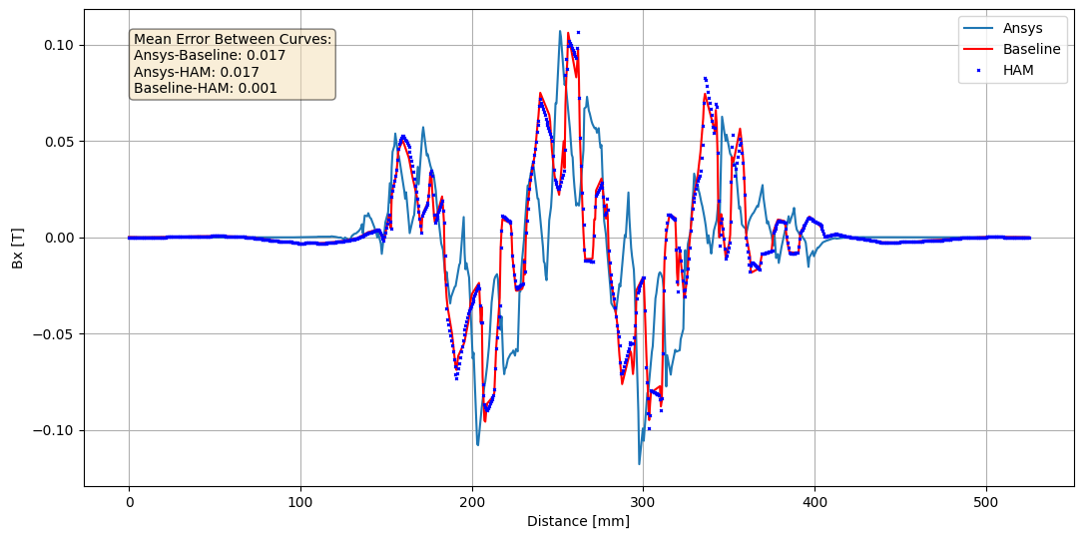
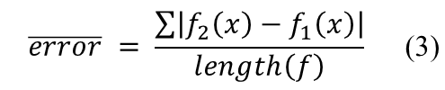
Defining Primary Motor Relationships
Mean Bx error in the airgap between ANSYS FEA and HAM plots is 0.017 T.
$$\overline{error} = \frac{\sum{\left|f_{2}\left(x\right)−f_{1}\left(x\right)\right|}}{length\left(f\right)}$$ | (3)
Fig. 6. Tangential magnetic flux density in the center of the air gap comparison between Ansys Electronics FEA (light blue), reference paper results (red), and the HAM produced in this thesis (dark blue).

Slide 14
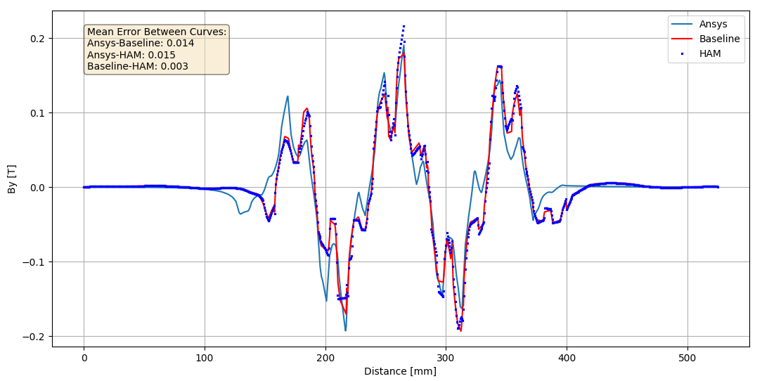
Defining Primary Motor Relationships
Mean Bx error in the airgap between ANSYS FEA and HAM plots is 0.015 T.
Fig. 7. Normal magnetic flux density in the center of the air gap comparison between Ansys Electronics FEA (light blue), reference paper results (red), and the HAM produced in this thesis (dark blue).

Slide 15
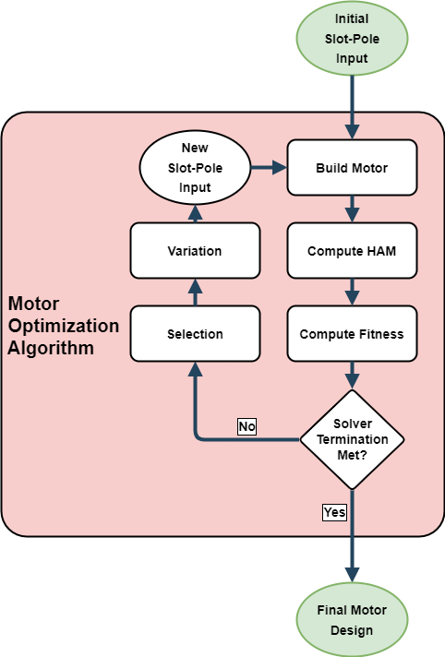
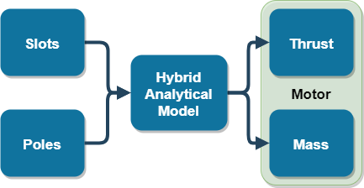
Optimization Algorithm
The solver execution loop objectively compares the generational performance until termination criteria is met.
Solver termination includes stalling, convergence, and timeout.
A well-tuned solver:
spares unnecessary executions.
Ensures robustness for the solution in the solution space.
Only two-three performance parameters can be chosen as objectives.
Power-to-weight is industry standard
Optimize the slot-pole relationship of a motor to maximize thrust to mass ratio.
Fig. 8. Layout of the motor optimization algorithm inputs and the resultant multi-objectives.
Fig. 9. Flow chart of conventional genetic algorithm variable flow.

Slide 16
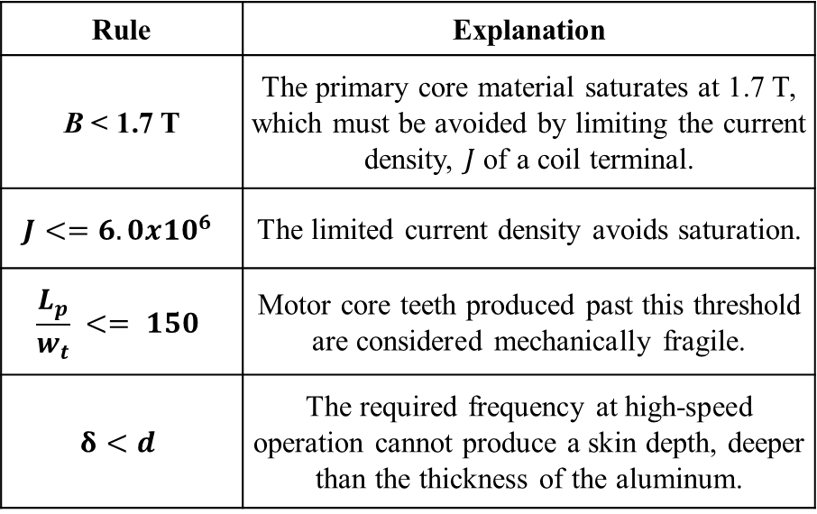
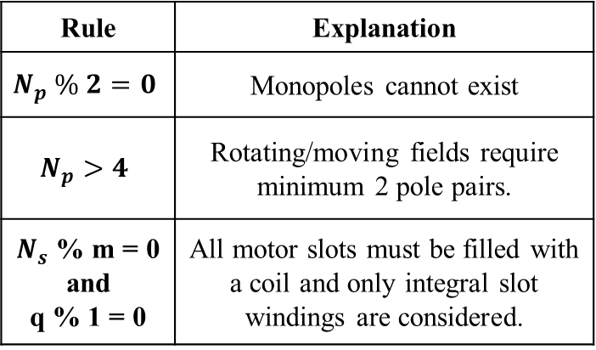
Feasibility Constraint
Table 7. Motor Feasibility Constraints Part 1
Rule | Explanation
B < 1.7 T | The primary core material saturates at 1.7 T, which must be avoided by limiting the current density, $J$ of a coil terminal.
$$J<=6.0x{10}^{6}$$ | The limited current density avoids saturation.
$$\frac{L_{p}}{w_{t}} <= 150$$ | Motor core teeth produced past this threshold are considered mechanically fragile.
$$δ<d$$ | The required frequency at high-speed operation cannot produce a skin depth, deeper than the thickness of the aluminum.
To ensure that all motors produced by the optimization algorithm are feasible, the model abides by the rules in Table 6 and Table 7.
Table 8. Motor Feasibility Constraints Part 2
Rule | Explanation
$$N_{p} \% 2=0$$ | Monopoles cannot exist
$$N_{p}>4$$ | Rotating/moving fields require minimum 2 pole pairs.
$N_{s}$ % m = 0 and q % 1 = 0 | All motor slots must be filled with a coil and only integral slot windings are considered.
If every solver iteration produces a feasible design, then there is no wasted computation.

Slide 17
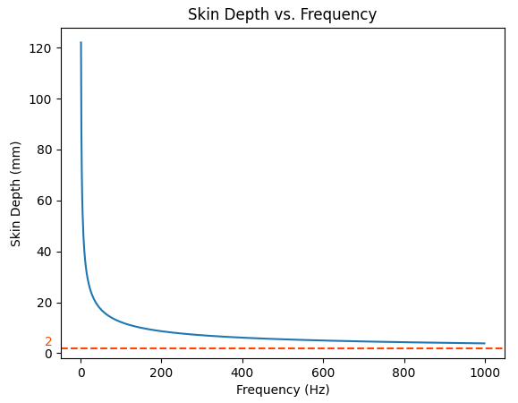
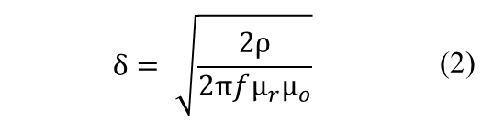
Skin Effect Constraint
It is important to consider the skin effect [16] if the motor application demands high speeds since the mechanical speed is directly proportional to the primary electrical frequency f from (2). The skin depth is calculated assuming low frequencies [17] as:
$$δ= \sqrt{\frac{2ρ}{2πfμ_{r}μ_{o}}}$$ | (2)
When plotting the skin depth across frequencies, the feasible frequency range before decoupling occurs.
Fig. 10. Skin depth (blue) in the secondary aluminum plate, with increased resistivity to account for the transverse end-effects, including the plate thickness (orange)
If the secondary material properties change, the primary motor top speed is affected

Slide 18
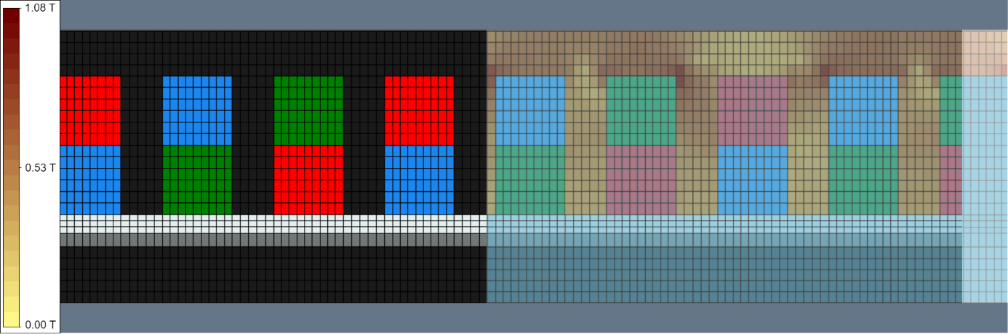

Primary Motor B Field Plotting
Fig. 11. Magnetic flux density (B) field plot in the motor core of the HAM simulation for the baseline motor to validate accuracy.
B field plotting validates the saturation constraint and allows for visual validation.

Slide 19
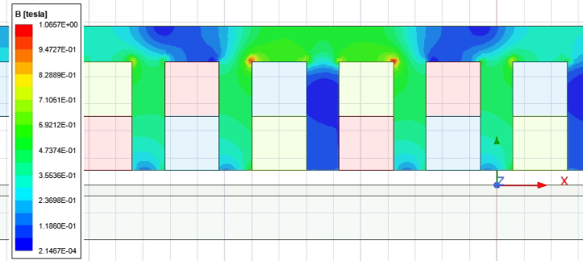
Primary Motor B Field Plotting
Fig. 12. Magnetic flux density (B) field plot in the motor core of the Ansys Electronics simulation for the baseline motor to validate accuracy.
The observed percent error of the magnetic flux density in the motor core between ANSYS and HAM was 1.3%.

Slide 20
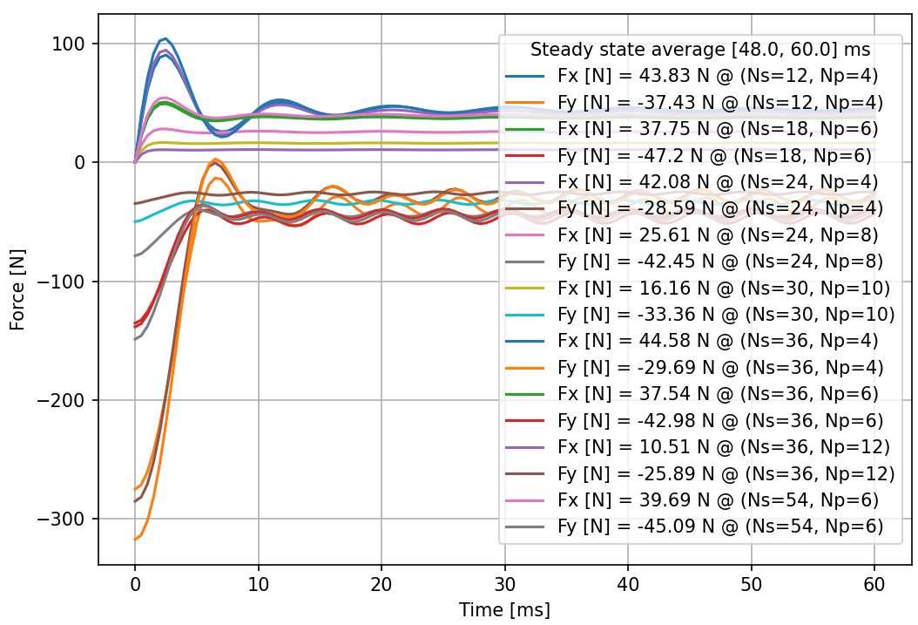
Primary Motor Force Comparison
Table 9. Motor Modelling and Optimization Domain
Configuration | Value
Iterations | 27
Optimization time (s) | 52.17
Motors modelled | 9
Ns (min, max) | (12, 54)
Np (min, max) | (4, 12)
The normal force in linear electric motors creates friction and mechanical constraints if not addressed.
Fig. 13. Transient tangential ($F_{x}$) and normal ($F_{y}$) force plot of all motors evaluated during the optimization process calculated as a steady state average between the time interval of 48 to 60 ms.

Slide 21
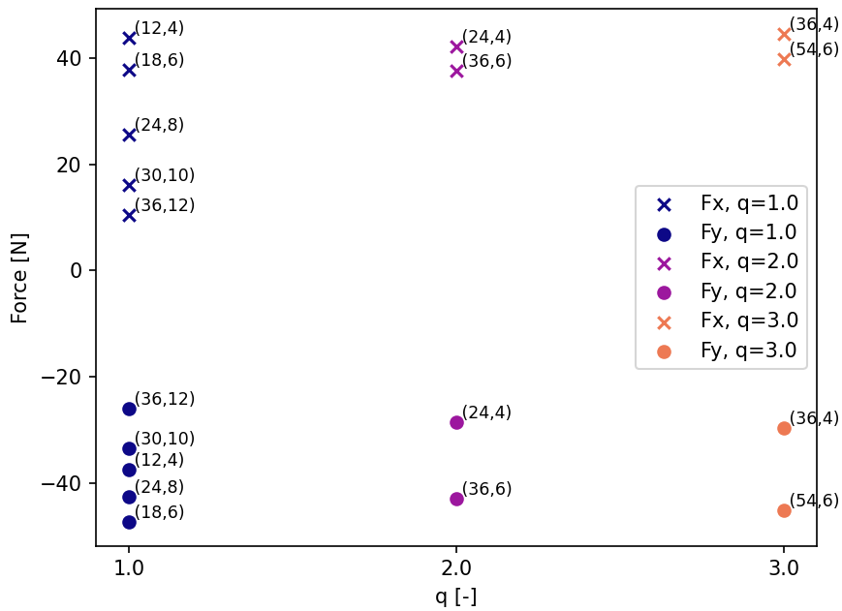
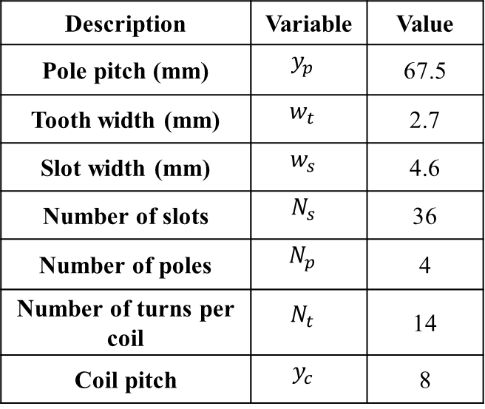
Primary Motor Forces Relative to q
Table 10. Optimal Motor Parameters
Description | Variable | Value
Pole pitch (mm) | $$y_{p}$$ | 67.5
Tooth width (mm) | $$w_{t}$$ | 2.7
Slot width (mm) | $$w_{s}$$ | 4.6
Number of slots | $$N_{s }$$ | 36
Number of poles | $$N_{p}$$ | 4
Number of turns per coil | $$N_{t}$$ | 14
Coil pitch | $$y_{c}$$ | 8
Categorizing by the value of q allows visually produced a trend across the motor domain.
Fig. 14. Average steady state thrust plot with data point annotations in the format: ($N_{s}$, $N_{p}$) grouped by the x-axis into columns of q values.

Slide 22
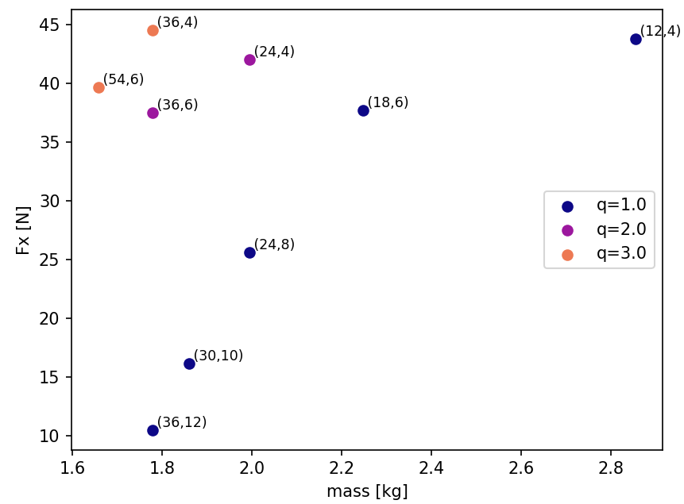
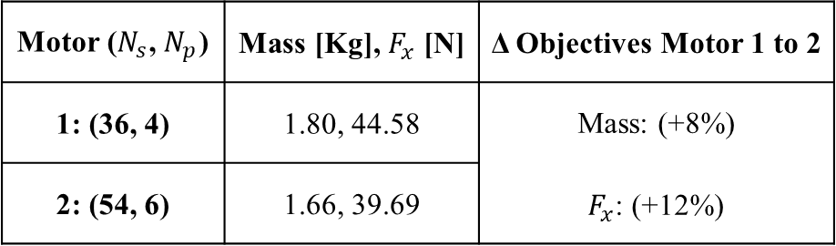
Optimal Solution Trade-offs
Designer Validation:
A Pareto-optimal solution plot allows the user to verify the solver’s solution.
Table 11. Comparison of Two Top Performing Motors
Motor ($N_{s}$, $N_{p}$) | Mass [Kg], $F_{x}$ [N] | Δ Objectives Motor 1 to 2
1: (36, 4) | 1.80, 44.58 | Mass: (+8%) $F_{x}$: (+12%)
2: (54, 6) | 1.66, 39.69
The solver may not produce the ideal motor for the application, requiring designer intervention.
Fig. 15. Pareto plot of the objectives: motor mass (x-axis) and average steady state thrust (y-axis), with data point annotations in the format: ($N_{s}$, $N_{p}$).

Slide 23
Concluding Statements
Motor Level:
The optimal motor within the domain of 12-54 slots and 4-12 poles, where 9 feasible motors were objectively compared, has 36 slots and 4 poles. Optimal is defined as maximal thrust and minimal mass.
Model Level Objective:
When comparing ANSYS and HAM, the mean error was 0.017 T. The observed percent error of the magnetic flux density in the motor core between ANSYS and HAM was 1.3%.
Solver Level Objective:
The NSGAII efficiently reduced the domain to 9 mechanically and electrically feasible, high-performing motors within 5 minutes. The average time for configuring and simulating a motor from scratch in ANSYS takes 30 minutes.

Slide 24
Future Research
Reduce the motor constraints to optimize across a larger variety and number of motors.
Optimize across low-level parameters once the meta-parameters are determined.
Expand the allowable winding complexity using the WDT to increase the motor domain.
Investigate using an FEA motor modelling API to replace the custom HAM.

Slide 25
Publication to Date
A. Mollaeian et al., "Fourier-Based Modeling of an Induction Machine Considering the Finite Permeability and Nonlinear Magnetic Properties," in IEEE Transactions on Energy Conversion, vol. 36, no. 4, pp. 3427-3437, Dec. 2021, doi: 10.1109/TEC.2021.3085748.– Accepted

Slide 26
Comments and Questions
Thank You
Any comments, feedback or questions?

Slide 27
References
[1] J. H. Xue and F. P. Banko, “Pioneering the Application of High Speed Rail Express Trainsets in the United States,” Parsons Brinckerhoff, 2012.
[2] “Claude Nicollier,” Swissloop. [Online]. Available: https://swissloop.ch/prototypes/claude-nicollier/. [Accessed: 20-Jan-2023].
[3] “Ice 3,” Wikipedia, 14-Jan-2023. [Online]. Available: https://en.wikipedia.org/wiki/ICE_3. [Accessed: 20-Jan-2023].
[4] D. C. Horvath, S. D. Pekarek, and S. D. Sudhoff, “A scaled mesh/nodal formulation of magnetic equivalent circuits with motion,” IEEE Transactions on Energy Conversion, vol. 34, no. 1, pp. 58–69, 2019.
[5] T. T. Overboom, J. Smeets, J. W. Jansen and E. A. Lomonova, “Semi-analytical modeling of a linear induction motor including primary slotting”. In Proceedings of the 15th International Symposium on Electromagnetic Fields in Mechatronics (ISEF), Funchal, Portugal, 1–3 September 2011; pp. 1–8.
[6] S. Ouagued, A. Aden Diriye, Y. Amara, and G. Barakat, “A General Framework Based on a Hybrid Analytical Model for the Analysis and Design of Permanent Magnet Machines,” IEEE Transactions on Magnetics, vol. 51, no. 11, pp. 1–4, Nov. 2015, doi: 10.1109/tmag.2015.2442214.
[7] B. L. Gysen, E. Ilhan, K. J. Meessen, J. J. Paulides, and E. A. Lomonova, “Modeling of flux switching permanent magnet machines with Fourier analysis,” IEEE Transactions on Magnetics, vol. 46, no. 6, pp. 1499–1502, 2010.
[8] B. Hague, “The principles of electromagnetism, applied to electrical machines,” in Electromagnetic Problems in Electrical Engineering, 1st ed. New York, NY, USA: Dover, 1962.
[9] J. Pyrhönen, T. Jokinen and V. Hrabovcová, “Design of Rotating Electrical Machines,” 2008.
[10] S. Yamamura, Theory of Linear Induction Motors, 1st ed., Wiley, 1972.
[11] S. Wang, Z. Zhu, A. Pride, J. Shi, R. Deodhar, and C. Umemura, “Comparison of different winding configurations for dual three-phase interior PM machines in electric vehicles,” World Electric Vehicle Journal, vol. 13, no. 3, p. 51, 2022.
[12] S. R. Aleksandrov, T. T. Overboom, and E. A. Lomonova, “2D hybrid steady-state magnetic field model for linear induction motors,” Mathematical and Computational Applications, vol. 24, no. 3, p. 74, 2019.
[13] K. J. Pluk, J. W. Jansen, and E. A. Lomonova, “Hybrid analytical modeling: Fourier modeling combined with mesh-based magnetic equivalent circuits,” IEEE Transactions on Magnetics, vol. 51, no. 8, pp. 1–12, 2015.
[14] “PYAEDT documentation 0.6.43#,” PyAEDT documentation 0.6.43 - PyAEDT. [Online]. Available: https://aedt.docs.pyansys.com/release/0.6/. [Accessed: 20-Jan-2023].

Slide 28
References
[15] M. Caruso, A. Di Tommaso, F. Marignetti, R. Miceli, and G. Ricco Galluzzo, “A general mathematical formulation for winding layout arrangement of Electrical Machines,” Energies, vol. 11, no. 2, p. 446, 2018.
[16] C. Timperio “Linear Induction Motor (LIM) for Hyperloop Pod Prototypes,” Published by ETH Zurich, Institute of Electromagnetic Fields (IEF), 2019.
[17] W. Hayt and J. Buck, Engineering Electromagnetics, New York: McGraw-Hill, 2012.

